Slide 1


SMART INDIA HACKATHON 2024
TITLE PAGE
Problem Statement ID – 1615
Problem Statement Title- Learning path dashboard for enhancing skills
Theme- Smart Education
PS Category- Software
Team ID-
Team Name:- DashMasters

Slide 2


Learning Path DashBoard
DashMasters
Problem:
Idea:
Need of variety of platforms
Various Material, Resources are not available at one Place
To create an interactive and personalized learning platform that enhances the educational experience by providing immediate answers, relevant resources, and real-time progress tracking with Growth Measurement- All things at one place.
No Particular Learning Path
No Personalized Learning Experience
No Growth Measurement

Slide 3
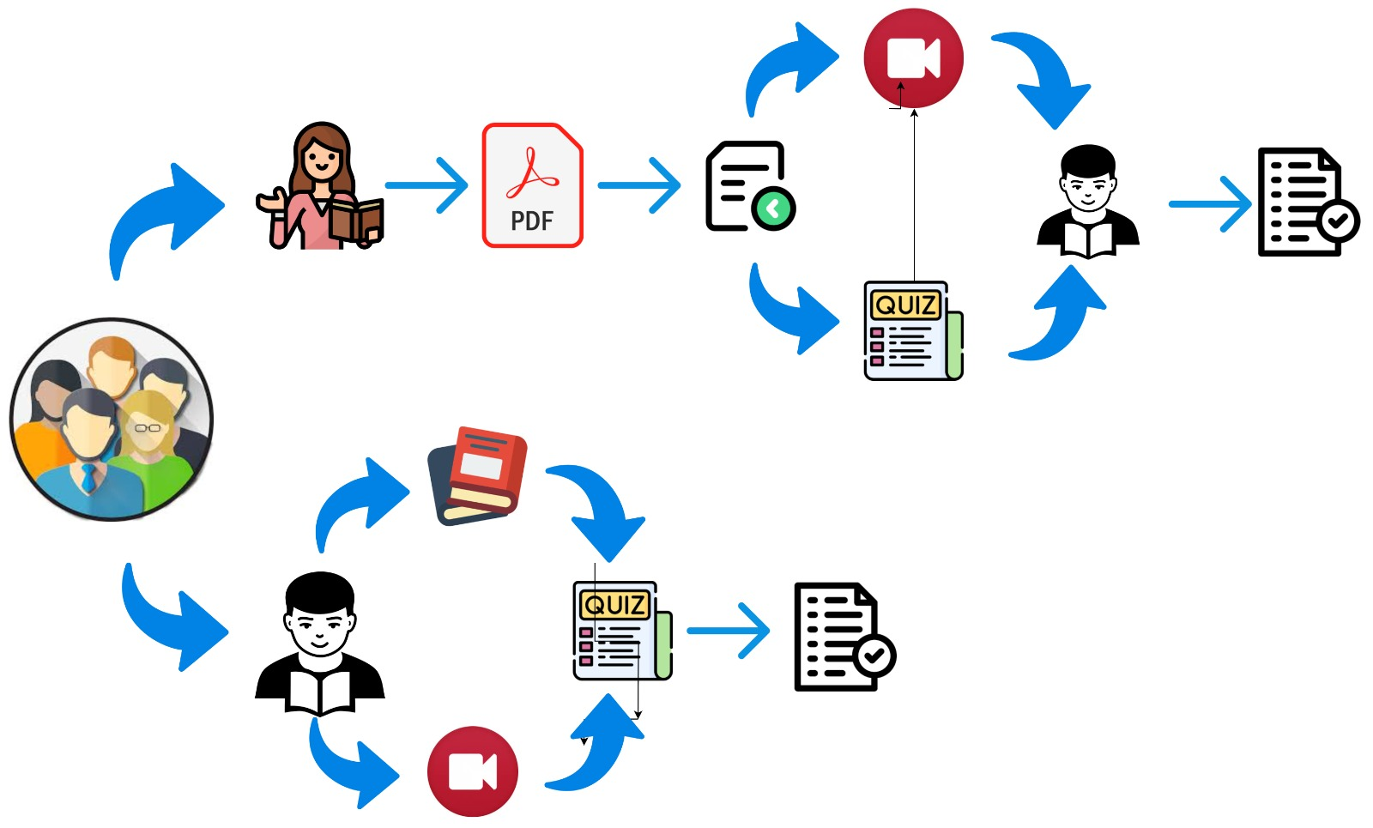
Learning Path DashBoard
DashMasters
Proposed Solution

Slide 4
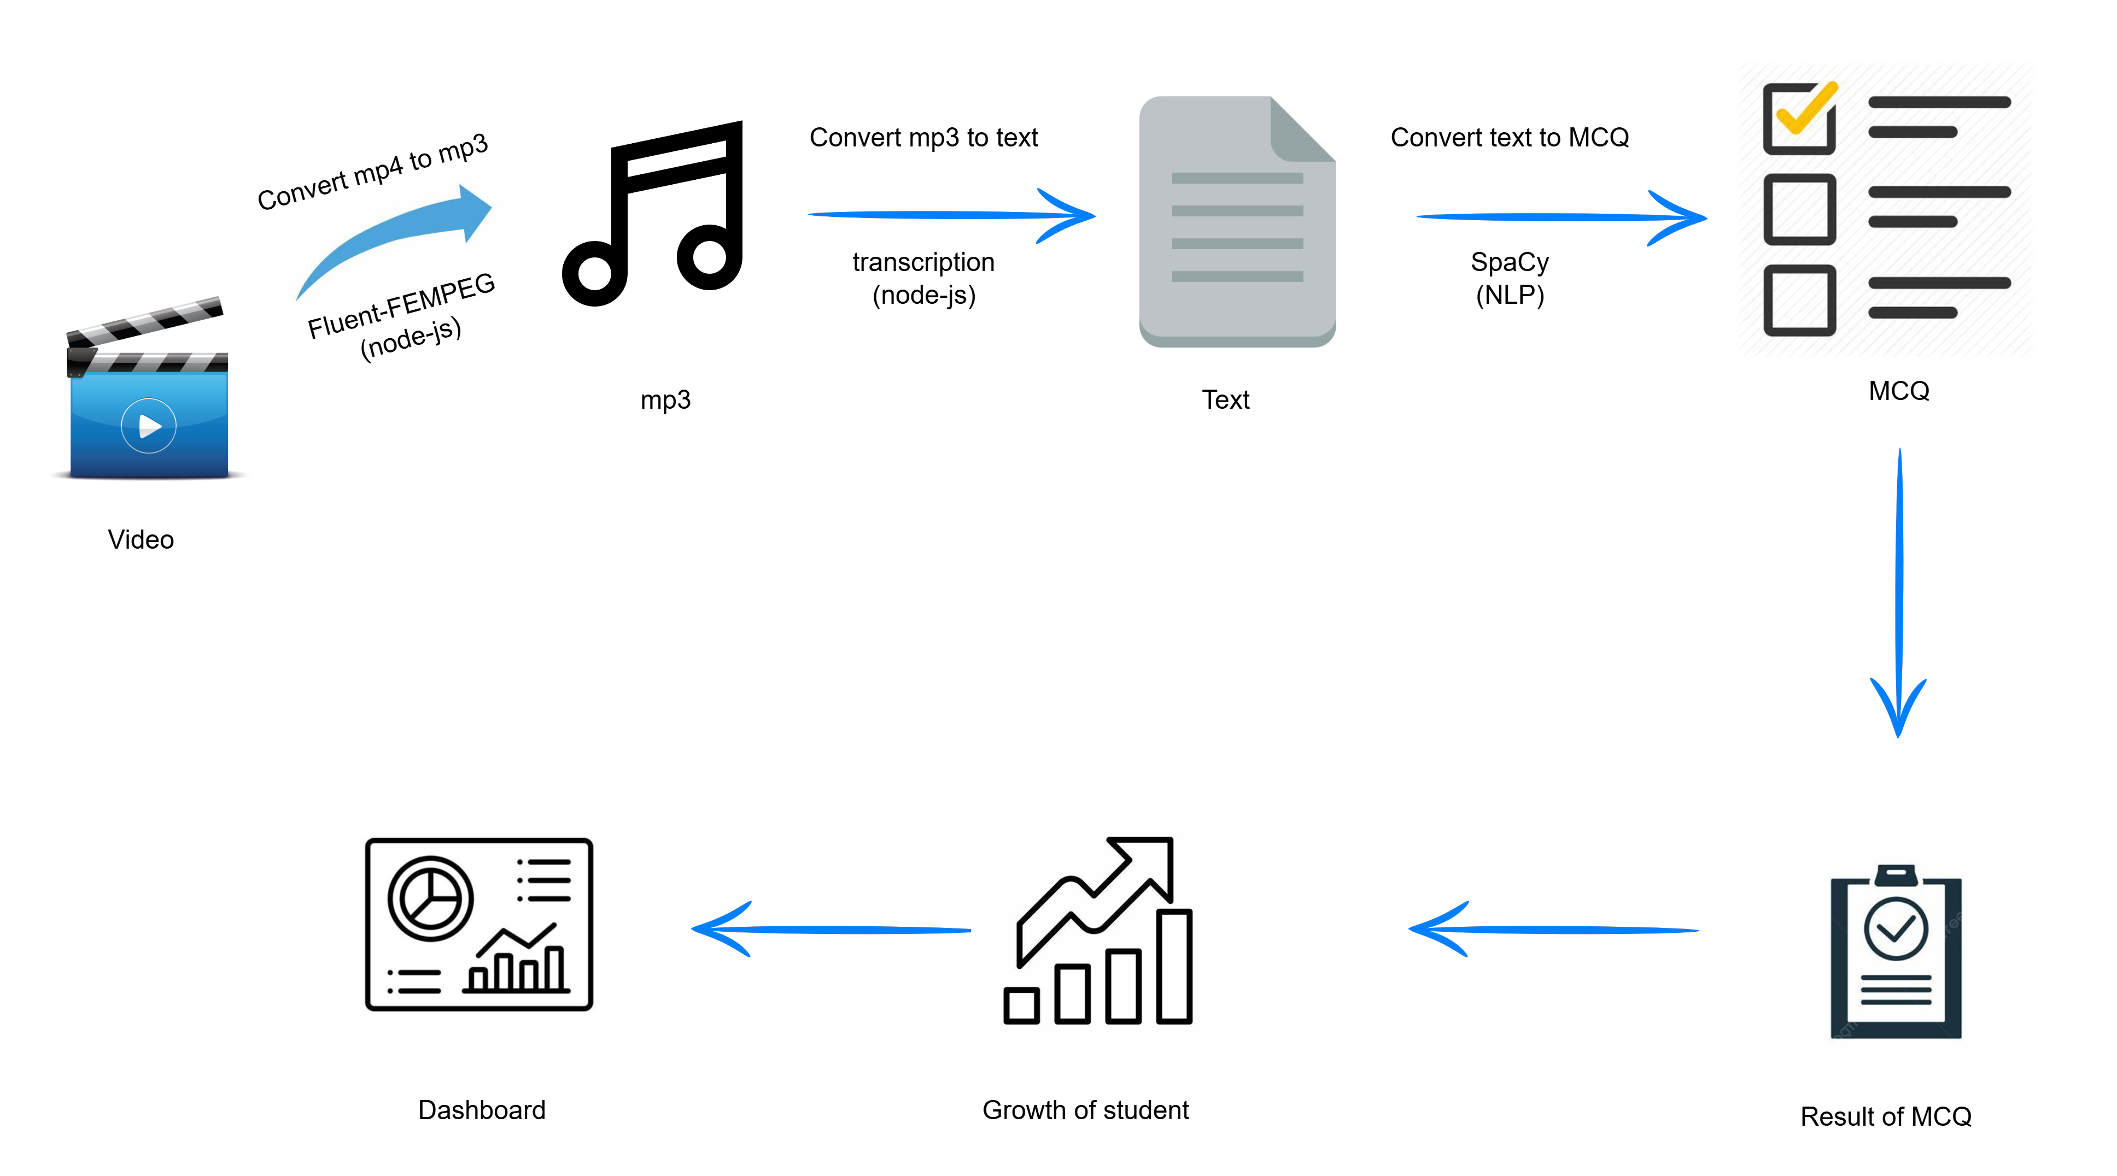






TECHNICAL APPROACH
DashMasters
Our Technology stack

Slide 5
FEASIBILITY AND VIABILITY
DashMasters
Analysis
Technology Stack
Content Management
User Experience
Scalability
Potential Challenges
Content Quality
AI Accuracy
Competition
Data Security
User Adoption
Solution
Content Quality
AI Development
User Experience
Provides Data Security
Differentiation

Slide 6
IMPACT AND BENEFITS
DashMasters
Potential Impact on the Target Audience
Enhanced Learning Experience
Accessibility of materials and videos.
Teacher Effectiveness
Social Benefits
Inclusive Education
Community Building
Economic Benefits
Cost-Efficiency
Skill Development
Environmental Benefits
Reduced Resource Consumption
Sustainable Learning
LONG TERM BENEFITS
To Make India’s Education Smart
MID-TERM BENEFITS
Everything on the One Platform for the students and teachers
SHORT TERM BENEFITS
Provides Personalized Learning Dashboards and reduces teacher’s Overhead of taking tests.

Slide 7
RESEARCH AND REFERENCES
DashMasters
https://it.delhi.gov.in/it/publications
https://it.delhi.gov.in/sites/default/files/generic_multiple_files/it-booklet.pdf
https://www.npmjs.com/package/youtube-search-api
https://pypi.org/project/PyPDF2/
https://pypi.org/project/spacy/

